Slide 1
Comparative Ethnography Final Project
By Riley Littman
COM 350-920

Slide 2
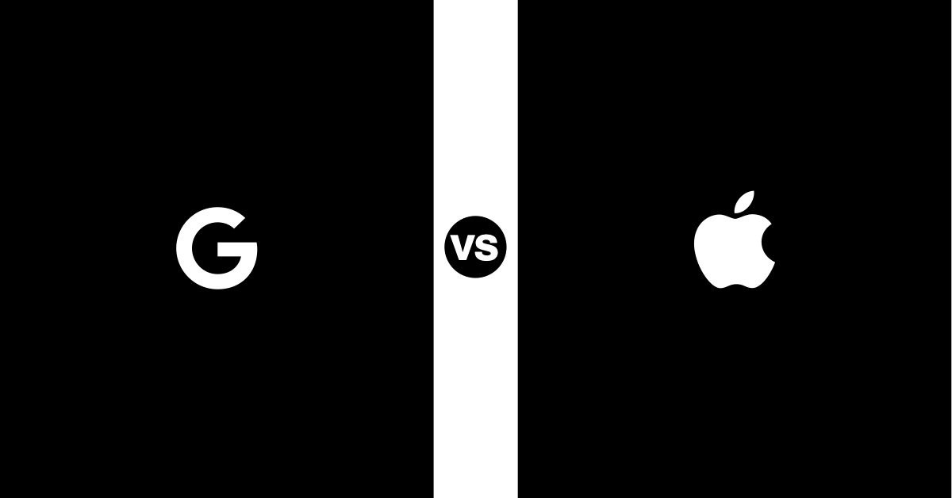
Apple vs. Google
The similarities and differences between Apple and Google's organizational communications and more.
A breakdown:
  Element one
    Comparing and contrasting Apple and Google's goals for their company and how they present them for employees
  Element two
    Comparing and contrasting Apple and Google's organizational communication.
  Element three
    Comparing and contrasting Apple and Google's socialization structures and new employee culture.
  Element four
    Comparing and contrasting Apple and Google's identity and difference in organizational life and diversity.
  Element five
    Comparing and contrasting Apple and Google's human relation/resource approaches.
  Element six
    Comparing and contrasting Apple and Google's approaches to progressive capitalism
  Element seven
    Comparing and contrasting Apple and Google's ethical communication.

Slide 3

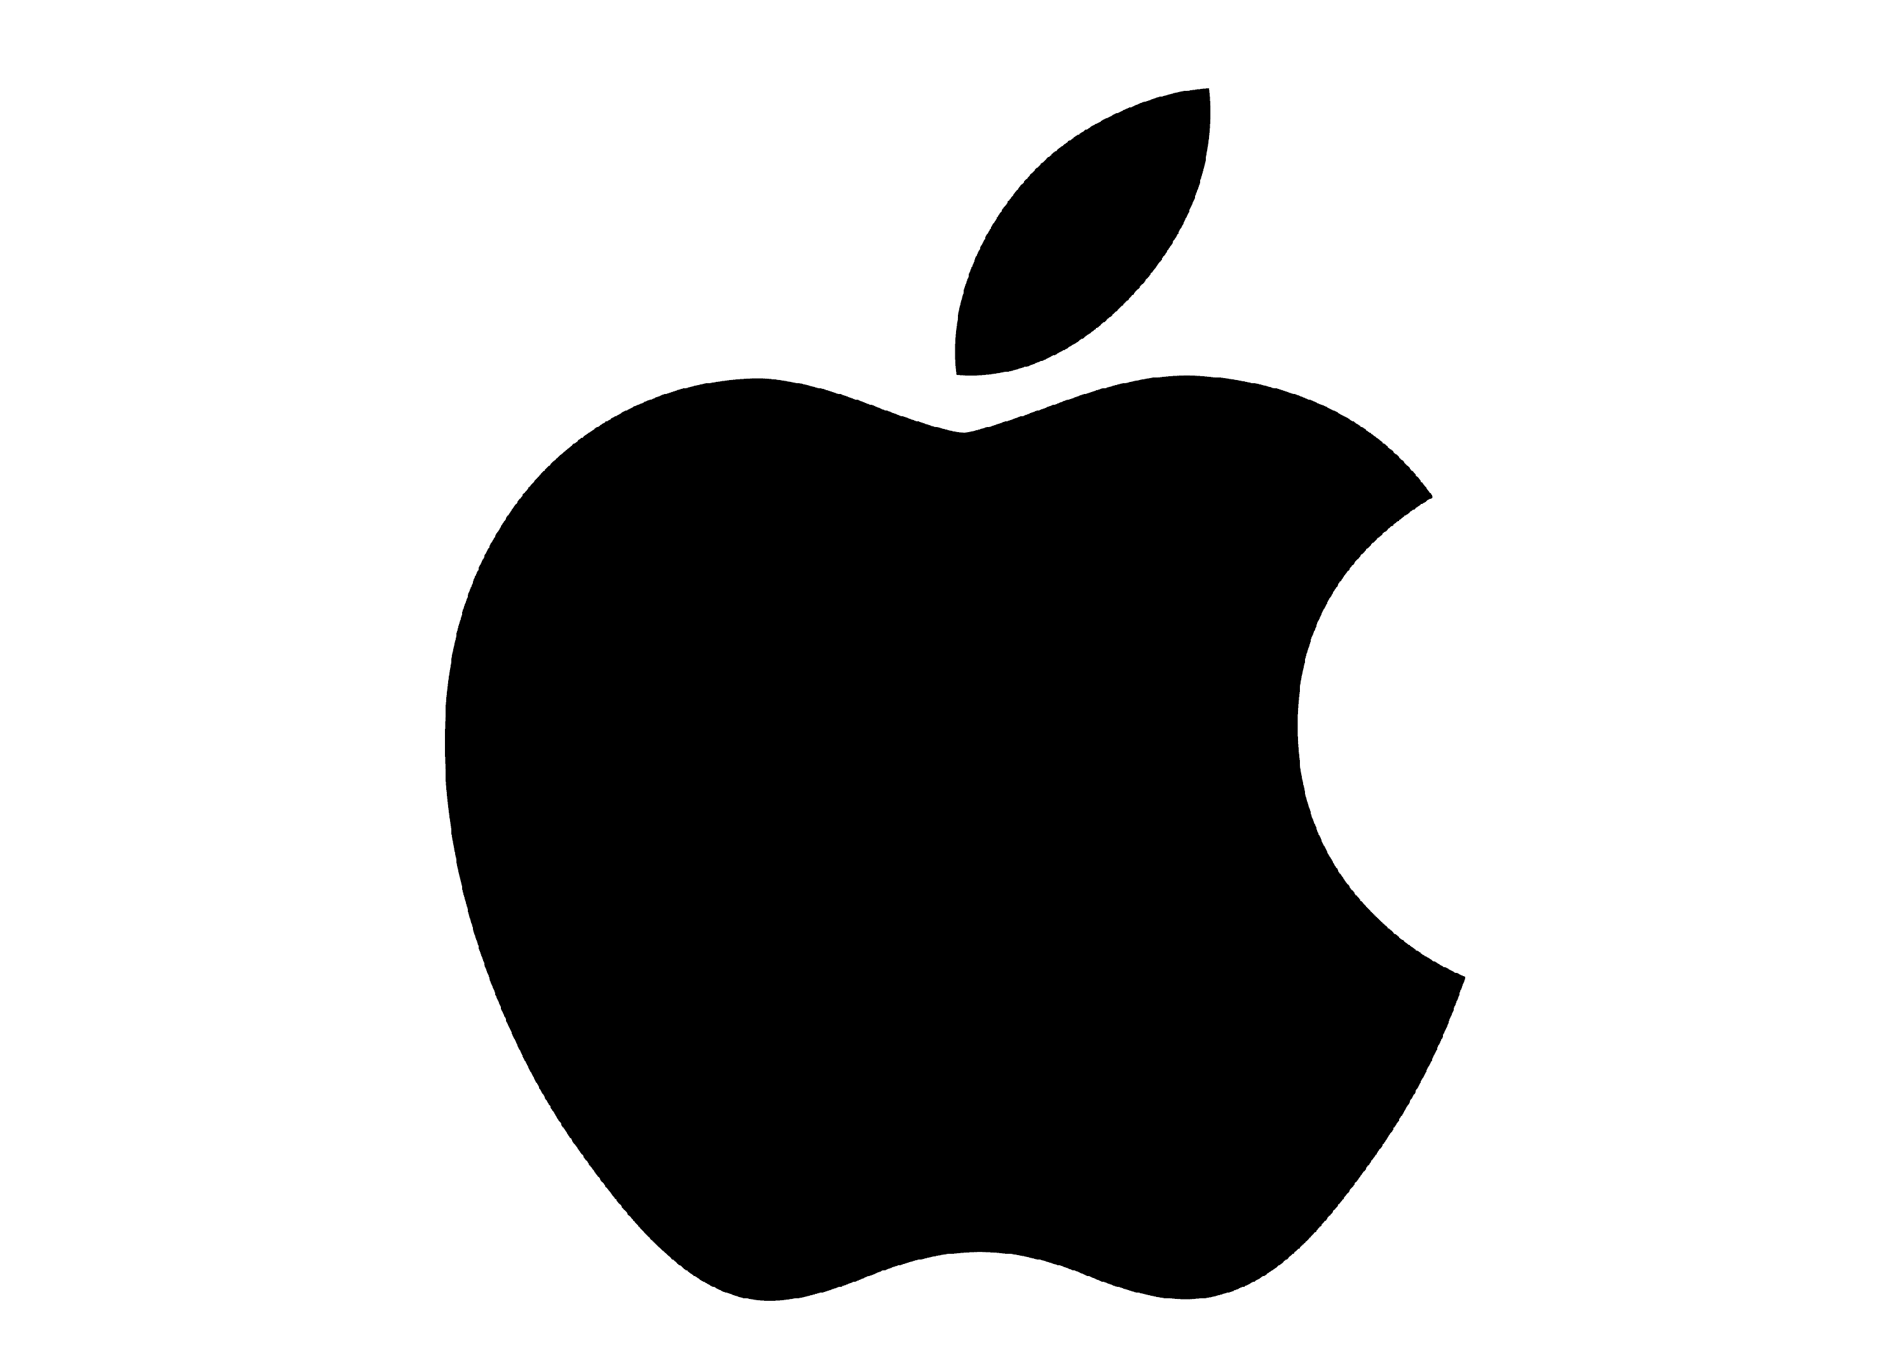
Background
Apple and Google are two of the most influential technology companies around the world. These companies have their own approaches, ideas, and products that are distinct and addressing different user needs.
Through the collection and analysis of data through interviews, advertisements, internet material and pictures, a comparison and contrast of the companies can be conducted.
Throughout this course, we learned a great deal about organizational communication and how different companies use this. Apple and Google show many similarities as well as differences in the way they conduct their businesses.

Slide 4
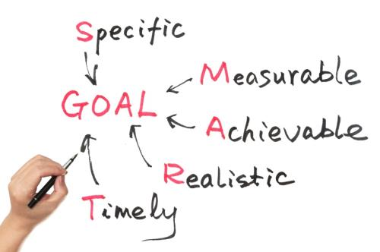

Organizational goal's
Organizational goals are defined in various ways in theories or organization and communication.
SMART goals: Individuals and organizations direct their activities toward goal attainment. Corporations such as Apple rely on SMART GOALS.
BHAGS: Priorities that are clearly articulated and shared with employees. Corporations like Google rely more on this objective.

Slide 5
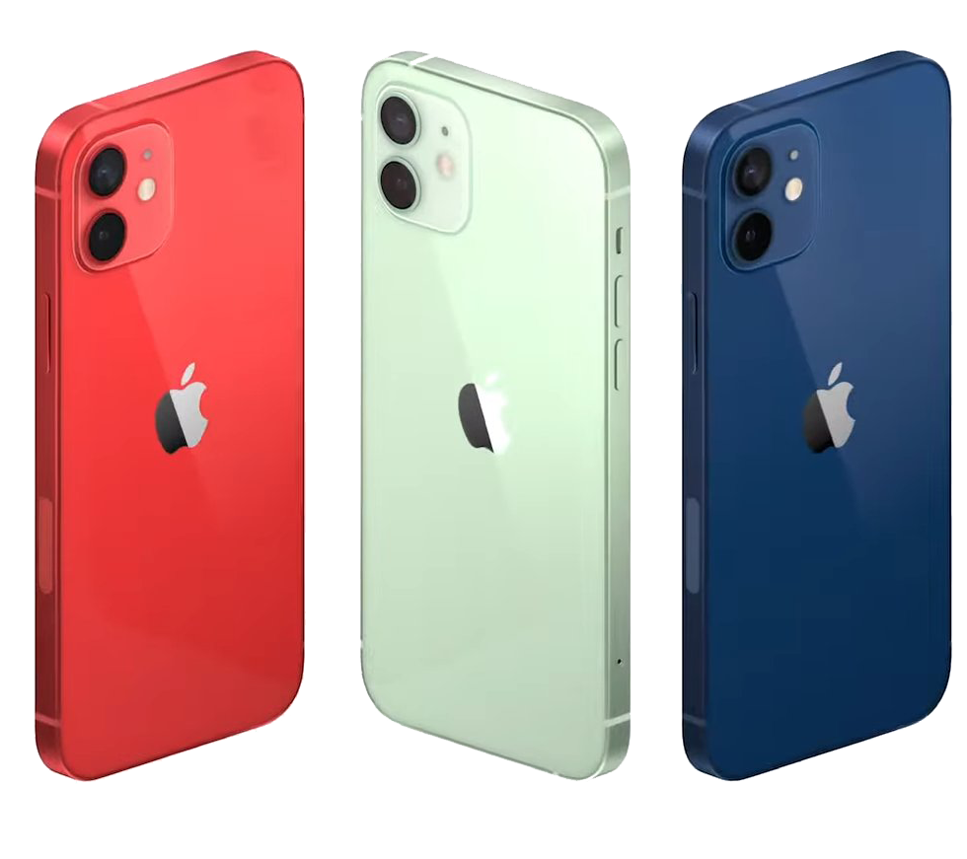
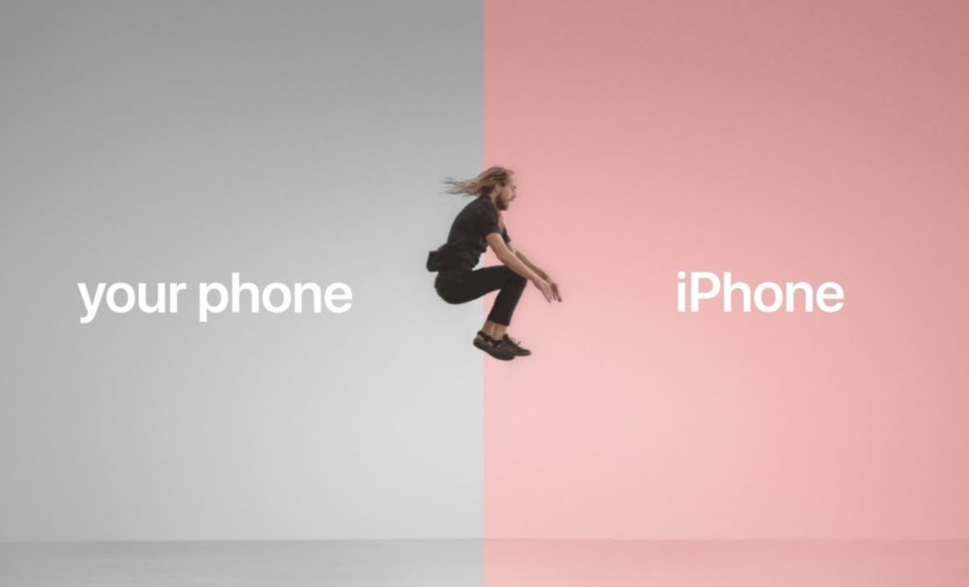
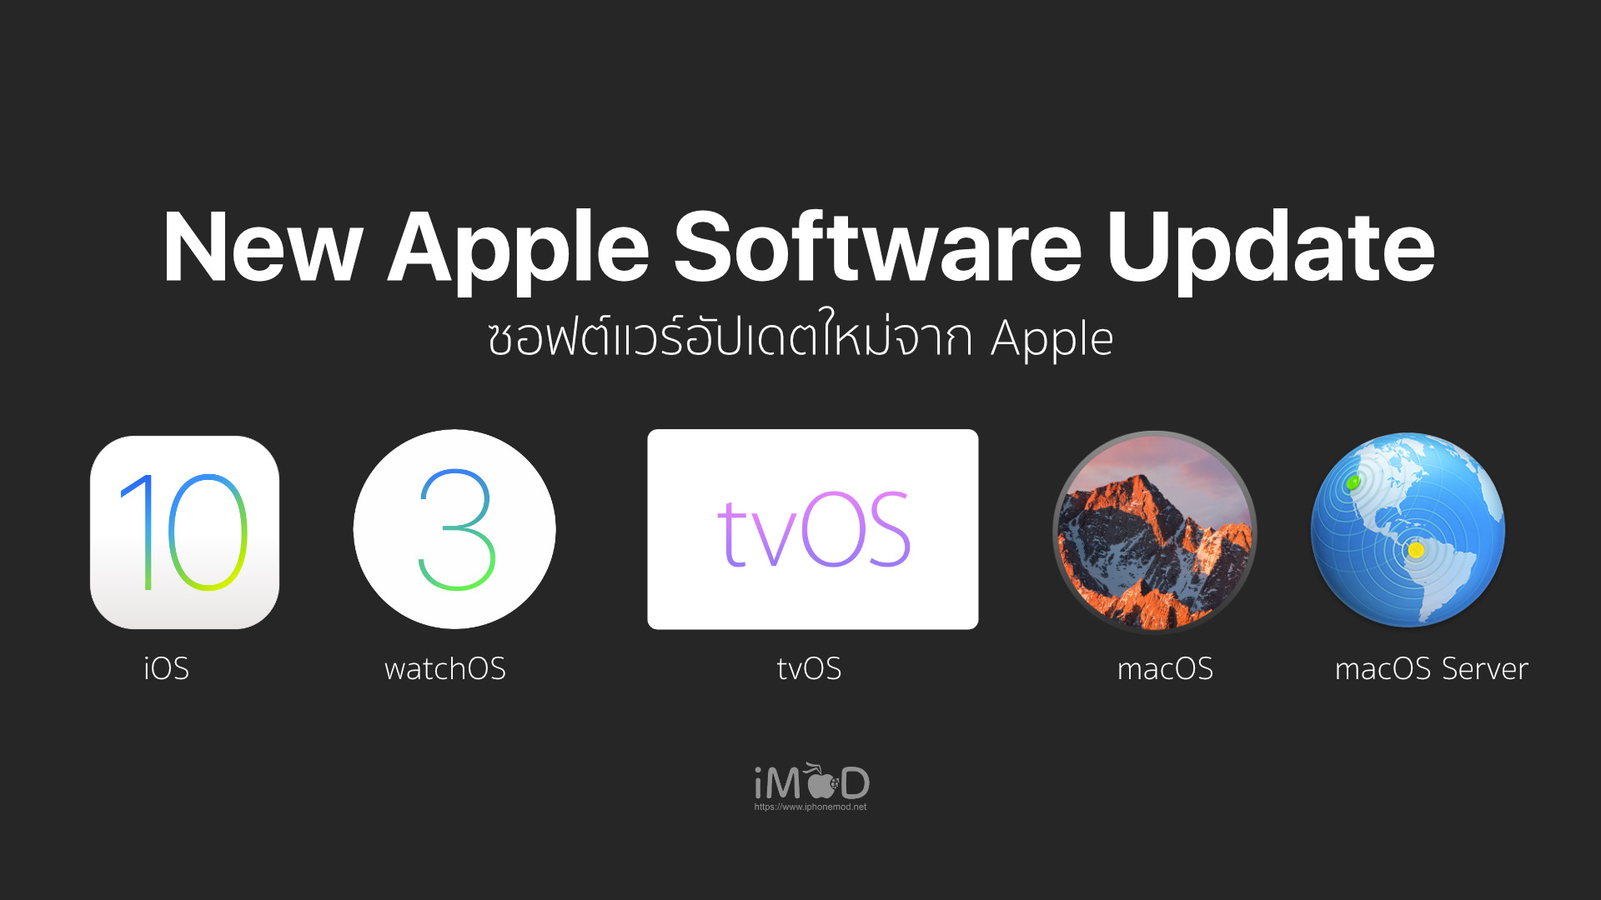

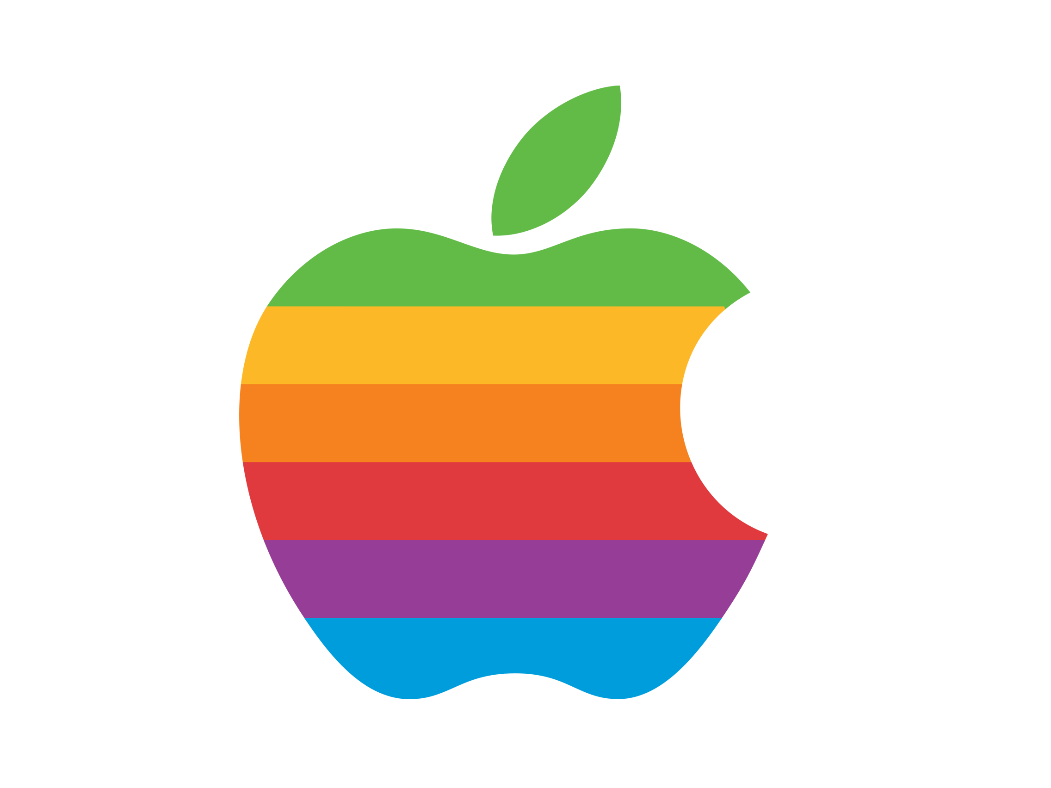
Apple's Smart goals
Specific
  Apple employees increase user traffic to be directed to Apple's website through social media posts and advertisements to boost new products. The new products are boosted by 5% from the previous released models.
Measurable
  Apple will track relevant KPIs to identify specific points to analyze such as conversion rates, hashtag usage, and customers satisfaction and loyalty.
Attainable
  To attain these goals, employees will utilize social media apps to direct consumers by announcing new releases and updates. They offer free, contactless delivery and online support.
Realistic
  Having a set goal of increasing social media engagement and tracking KPIs by at least 5%, Apple will continue to sell products to existing and new customers.
Time based
  With the most recent launch of the new iPhone 15, tracking of the SMART goals and KPIs within six months will allow quick feedback and insight on the product.

Slide 6
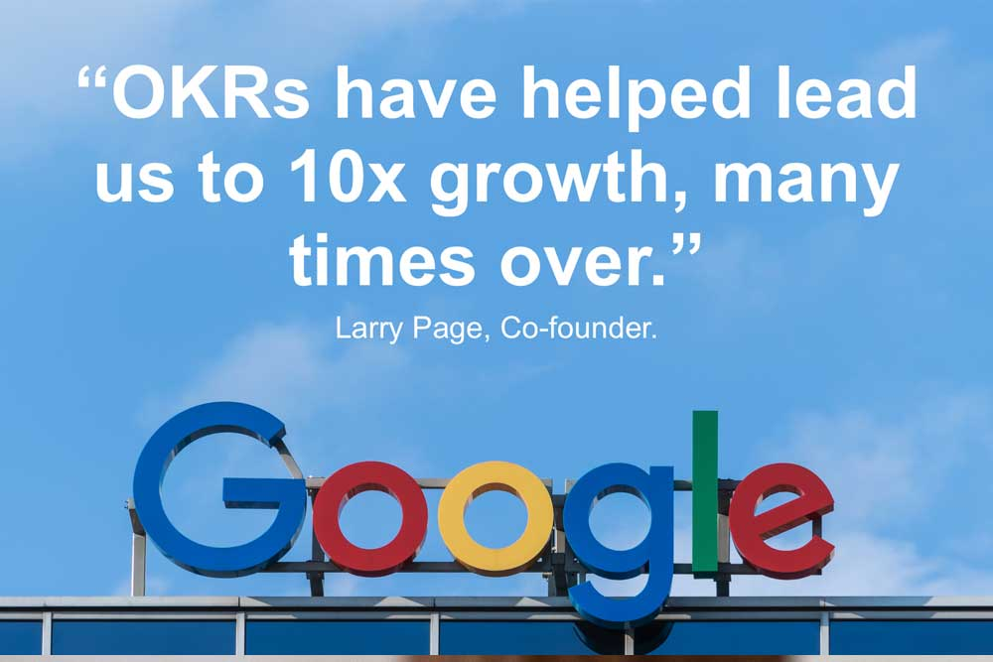
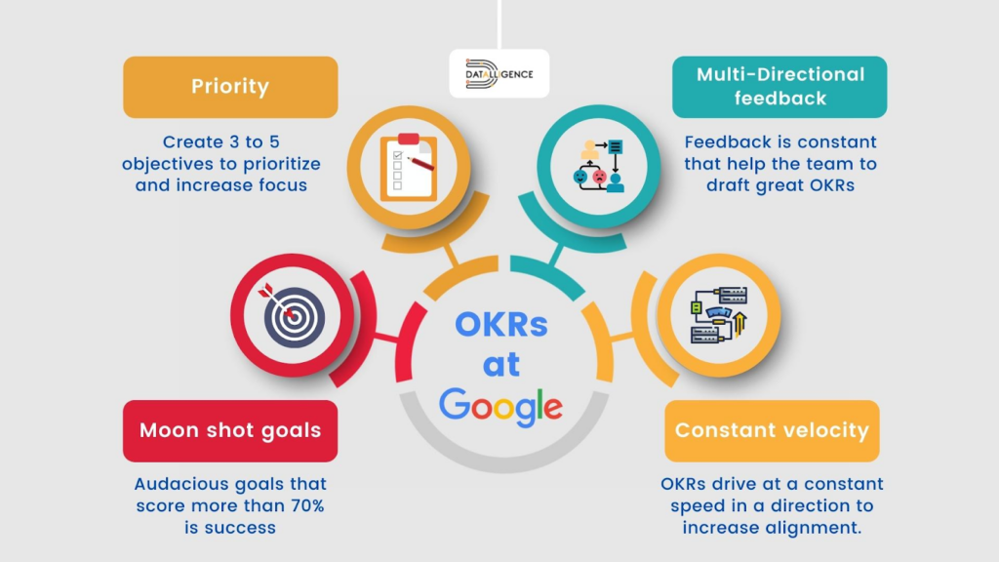
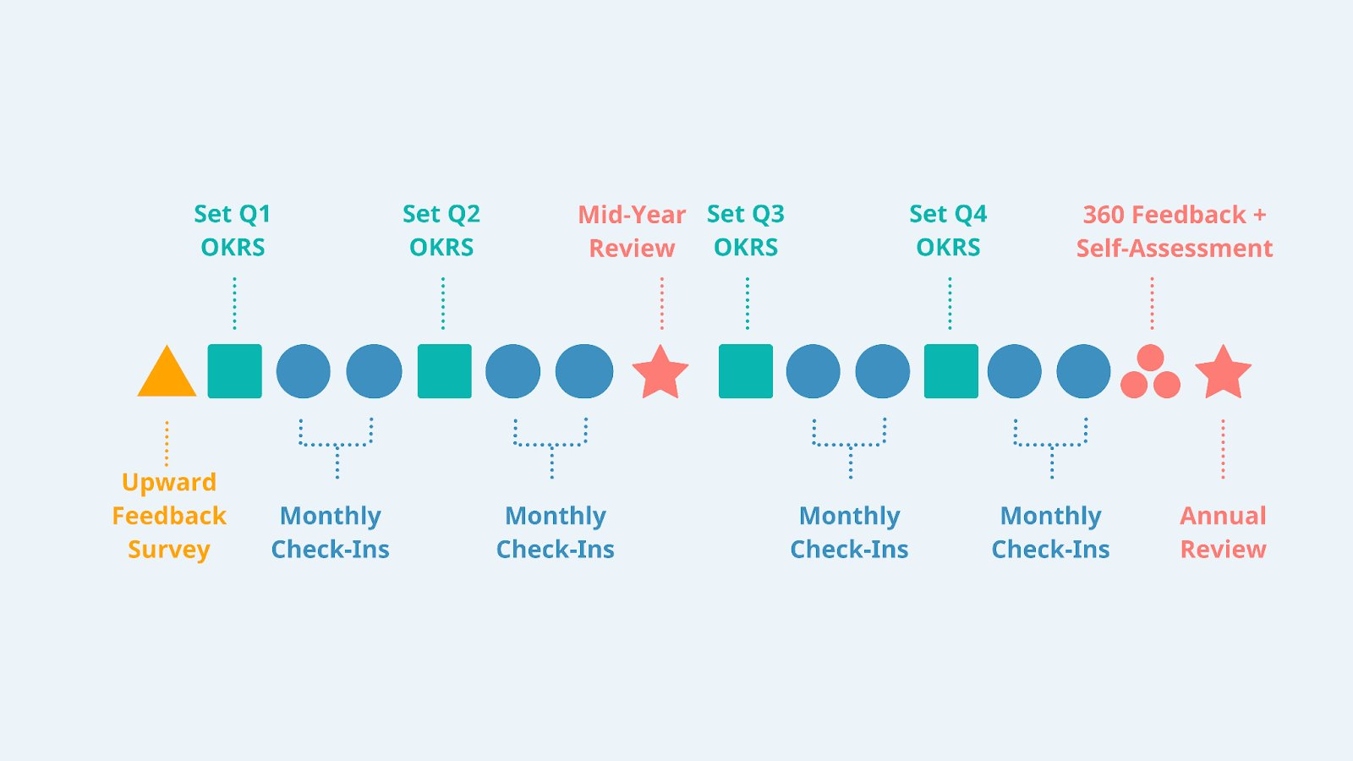
Google's goals
OBJECTIVES AND KEY RESULTS
Instead of using smart goals like apple does, google sets their goals by using OKRs. OKRs include objectives and key results and they outline what is wished to be achieved. They use similar objectives as smart goals such as being time-bound, specific, and measurable.
The objective express goals and intents that are aggressive yet realistic. To be successful they must provide clear value for google.
Key results express measurable milestones and if achieved they will advance objectives in useful manners. The KRs describe outcomes not activities and must show evidence of completion.

Slide 7
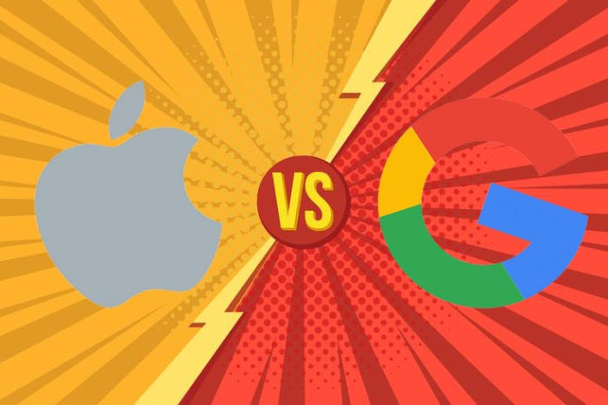
Comparing apple & Google's goals
Apple's organization using the SMART goal method when listing their goals.
While Google uses something similar, it is different. Google uses objectives and key results.
Both companies have similar ideas when trying to achieve their goals such as, both use measurable, specific, and time-bound objectives.
Lastly, Apple's goals seemed to be more detailed and laid out better for all employees. While Google's seemed to just be simple yet confusing for all employees to understand.

Slide 8


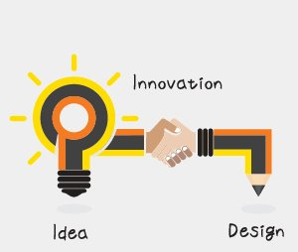
CREATIVITY AND CONSTRAINT
ORGANIZATIONAL COMMUNICATION
Communication is the moment-to-moment working out of the tension between organizational constraint and an individual's creativity.
Duality of structure is focused on the creative although constraining aspects of structure. When a designer is making a new advertisement, they are bound by the rules, norms and expectations of the industry while having openness of transcending the structures into a creative ad.
The theory of structuration sees people's behaviors as unresolvable, and productive tension between creativity and constraint.
Module 2 concepts
Creativity
  Innovative thinking, willing to reexamine routines and practices, and encouraging new ideas
Constraints
  Deadlines, financial limits, organizational rules.

Slide 9
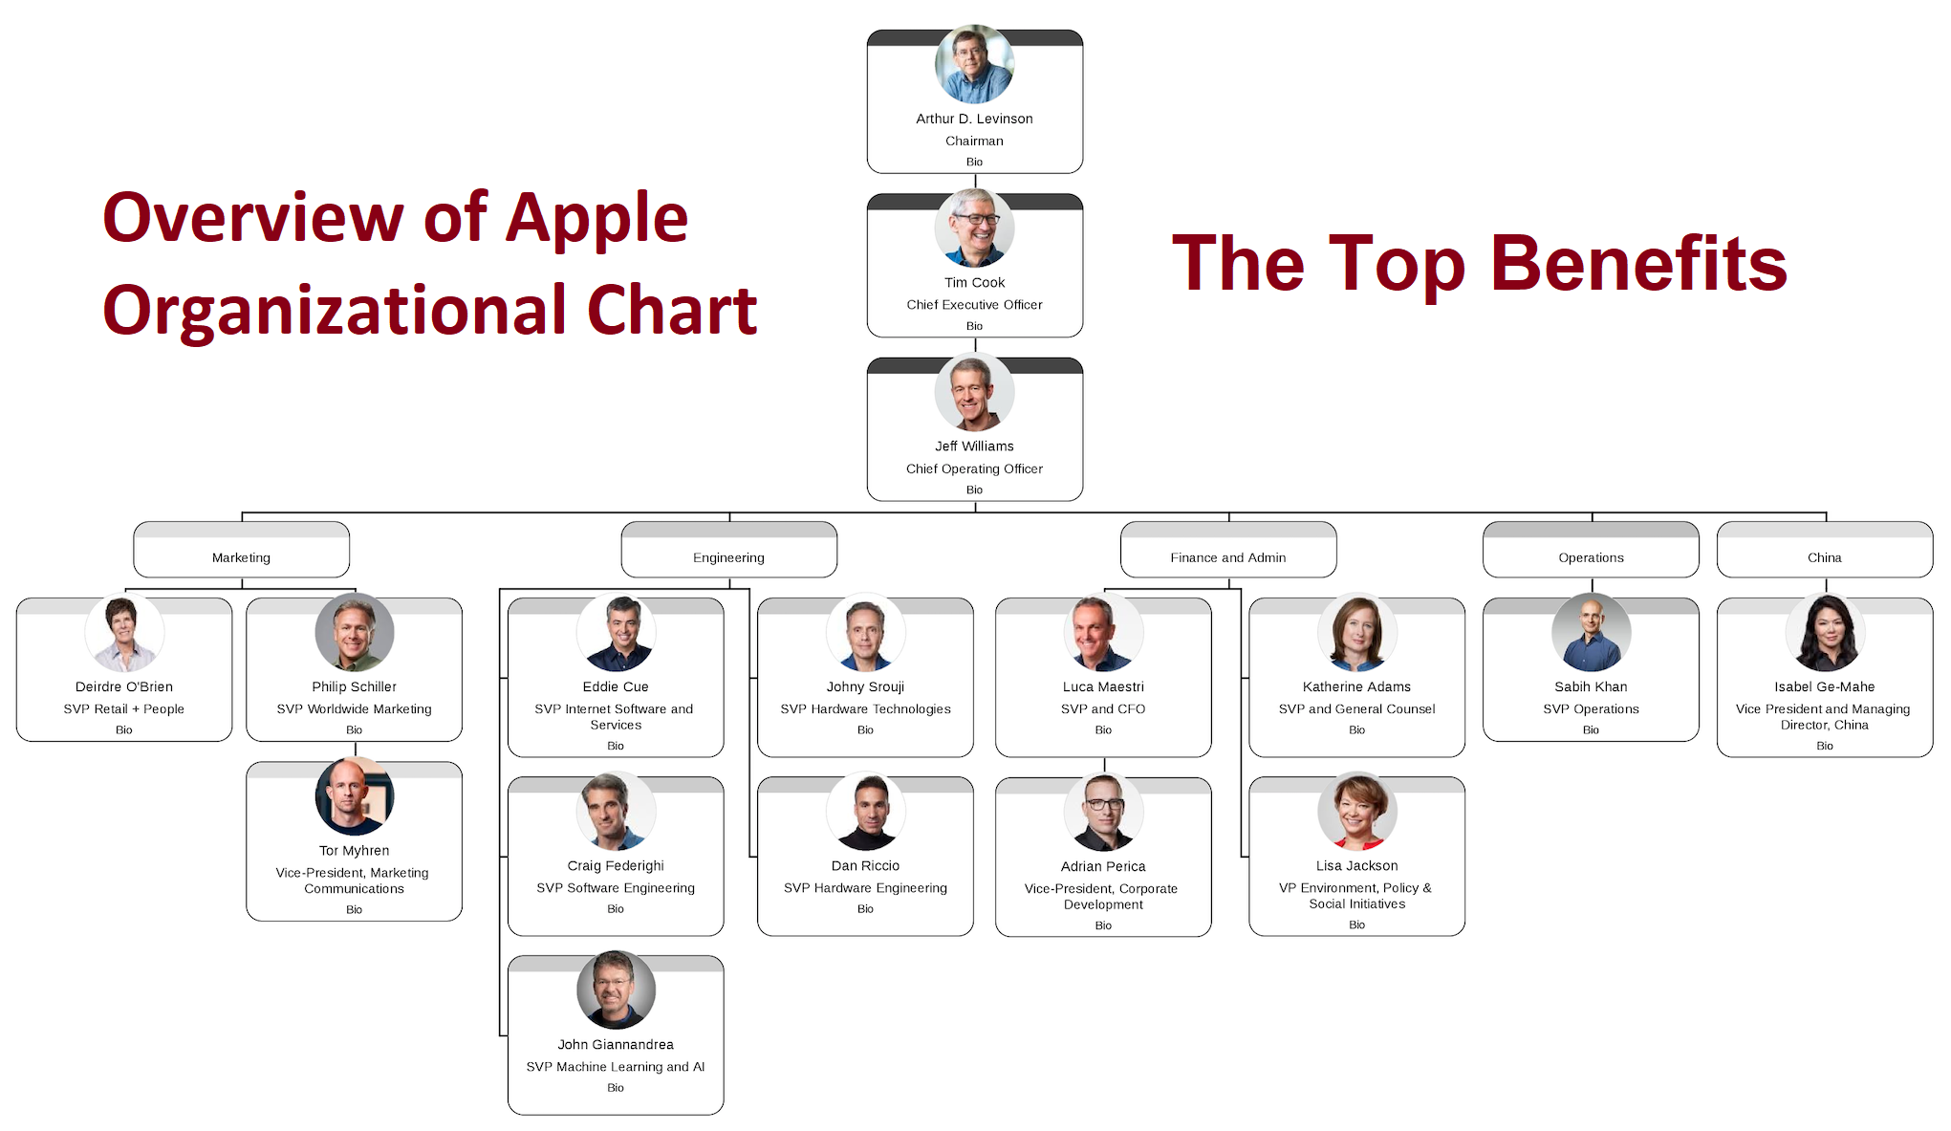
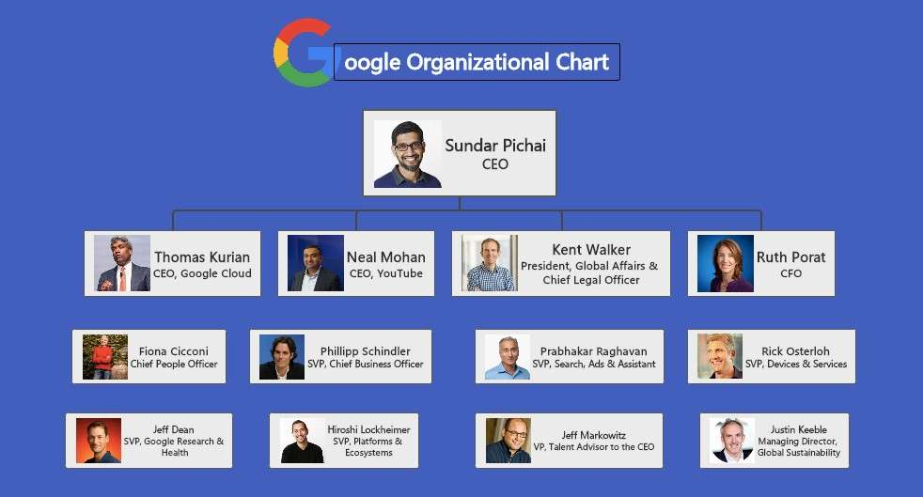
Apple & Google's organizational strategies
Apple
Google
Relies on structure that focuses on expertise and experience.
Considers costs and revenue goals but in different ways than conventional organized companies.
Rely on technical experts rather than general managers.
Mission is to organize information and make it accessible and useful universally.
Makes sure their employees feel connected and empowered by the issue their focused on.
Shares everything with their employees and communicates why decisions are made.

Slide 10
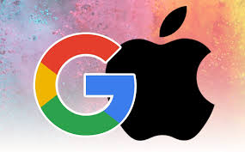
Socialization adding members to organizational cultures
Anticipatory socialization
Vocational
Occurs in childhood, learning from family members, etc.
Organizational
This is later in life when an indnvidual will learn about the specifc job & organization.
Before the first day, through company literature,interactions between interviewers, etc.
Organizational assimilation
Involves both surprise and sensemaking
The new employee will learn the requirements of their role and what that organization considers normal patterns of thought and behavior for their members.
Learn about how exisiting members define the organization's culture.
Overtime, new members will evolve into full-fledged members.
Socialization is defined as the process of which people will learn norms, rules, and expectations of the organization's culture over time.
For socialization to be successful for an organization's new members, the organization must help the new members feel integrated into the culture.
The new employee's first week or so may be filled with surprises and mistakes, eventually the employee with learn the formal and informal rules of the company.
Two broad stages come along with this learning process:
Anticipatory socialization and organizational assimilation.

Slide 11
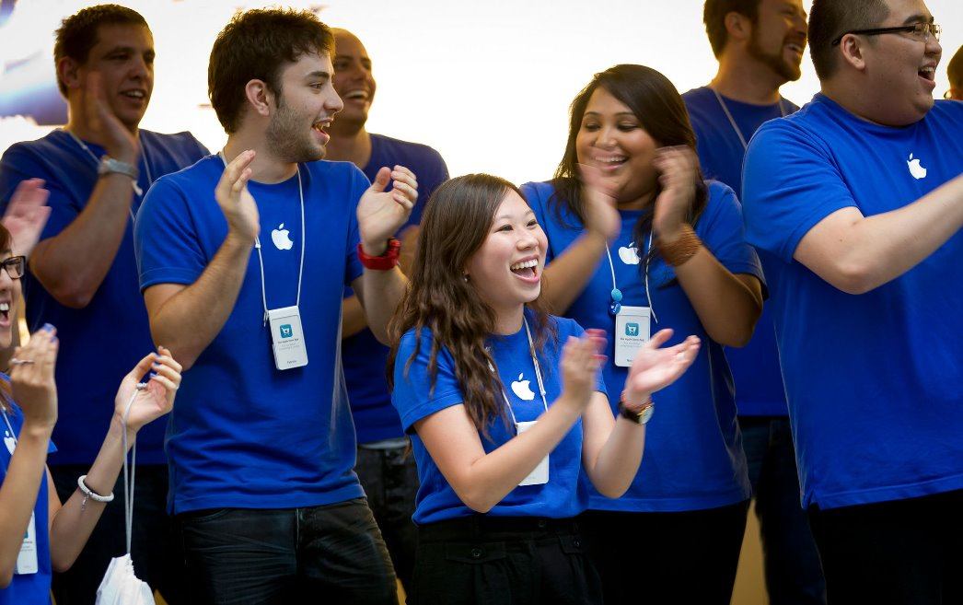
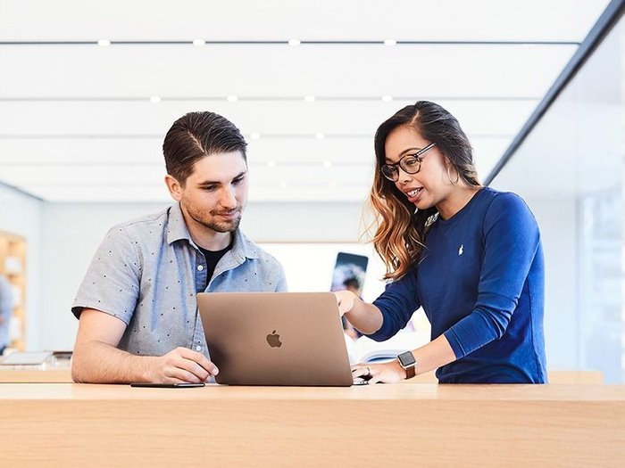
Apple's socialization process
How Apple helps new employees adapt to prevailing culture:
During prearrival stage:
Employee has expectactations from work.
During encounter stage:
Confront the possiblity that their expectations may differ from reality.
During metamorposis stage:
Employee will change & adjust based on group work & culture.

Slide 12
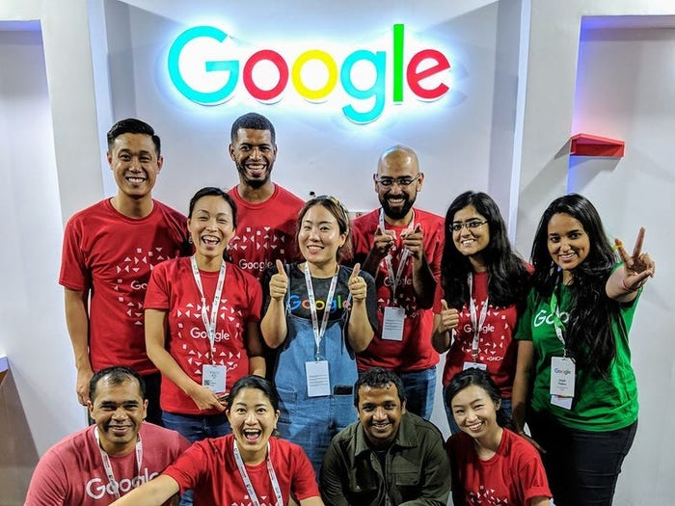
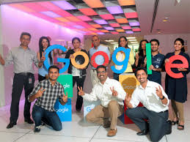
Google's socialization process
During the anticipatory stage:
  Google provides a list of things the new employee is expected to know.
During the encounter stage:
  Asked a series of questions and be put into team like scenarios.
  Higher ups will check on the new employee to see how they are doing as well as ask other employees how the new member is.
During the metamorphosis stage:
  Once joined the team, member will speak with their boss to create a bond.
  Understand Google's environment & what it means to employees.

Slide 13
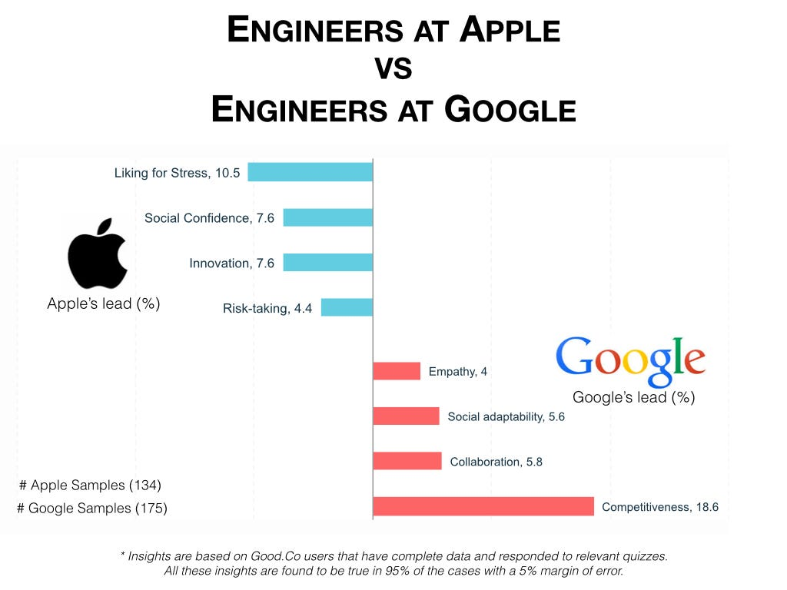
Compare the socialization process
Both companies have similar criteria for the first stage, but they use different names for it. Google calls it the anticipatory stage while Apple stated it is the prearrival stage.
  Google will provide the employee a list of expectations, while Apple expects the employee to have expectations from previous work.
For the next stage, the encounter stage, they have the same name.
  For Apple, this is when the new member will realize their expectations may be different from reality. And for google, the new member will begin getting asked questions and getting checked up on from their higher-ups.
The last stage, has the same title as well, the metamorphosis stage.
  Both goals for this stage in the companies are very similar. The new employees will learn the culture at their new jobs and understand what it means to be an employee there.

Slide 14

Identity and difference in organizational life
A way to understand identity and difference in organizational life is from the belief that the organization itself has an identity. It has been suggested by scholars, that organizations themselves can be gendered.
Within this framework, gender will play a crucial role for shaping identities in ways that can be overlooked. A gendered organization is one that shows patterns of a distinction between male and female through advantages, disadvantages, action and emotion, etc.
A gendered organization can emerge through 4 processes:
  Social construction of divisions of labor, positions, & types of work along gendered lines
  Social constructions of symbols & images that reinforce gender divisions
  Uninterested communication interactions between men & women, men & men, and women & women.
  Ways that individual actors take up identities that reinforce the 3 processes above.

Slide 15
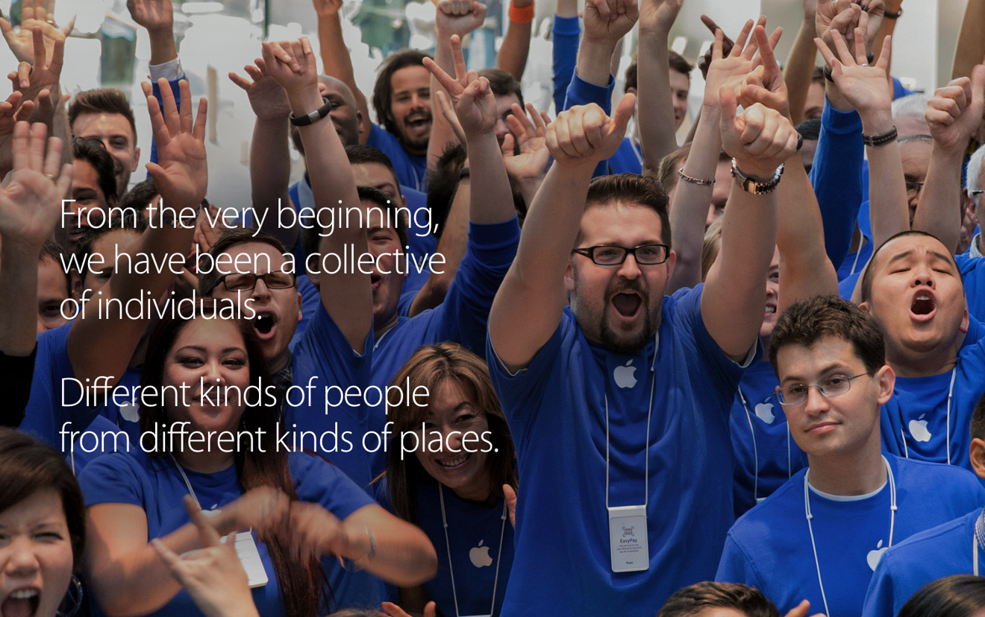
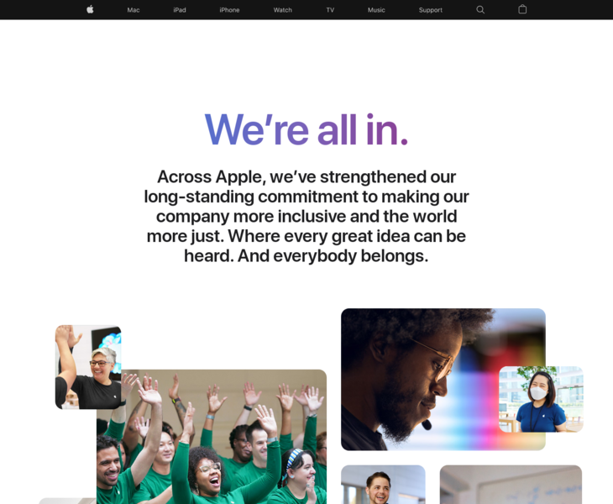
Apple's diversity
Apple's first diversity report showed that 70 percent of its 98,000 employees all over the world were white males. Years ago, Apple could have been considered a gendered organization.
However, Apple has changed its diversity and inclusion over the years. Over the last 5 years, Apple has hired more women and underrepresented minorities to grow their team.
They have achieved pay equity in every country that they operate in.
  Women earn the same around of pay that men do in performing similar work.
  Underrepresented minorities earn a dollar for every dollar a white employee earns.
Apple welcomes all voices and beliefs.
  They hire & support U.S. veterans & advocate on behalf of LGBTQ+.

Slide 16
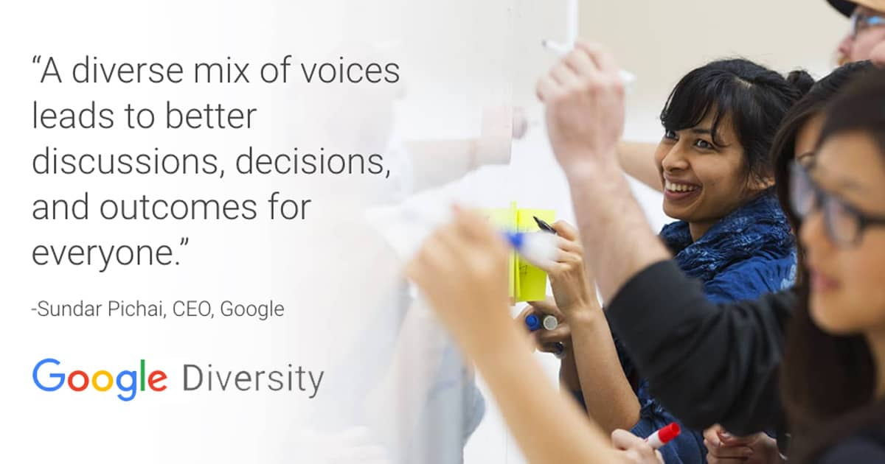
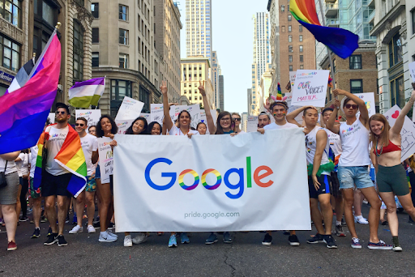
Google's diversity
In 2020, Google had made commitments in their efforts to increase diversity and inclusion but even years later, there have been significant cuts in these programs.
  95,000 employees were classified as male and 37,000 as female.
Overtime, Google has improved their diversity and inclusion. In 2023, their diversity report showed that they had the highest-ever representation of women in leadership, tech, and non-tech roles worldwide.
Since 2020, Google has increased:
  Percentage of women employees
  Hiring people from historically underrepresented backgrounds in the tech industry.
  Spending more money with diverse-owned suppliers.

Slide 17
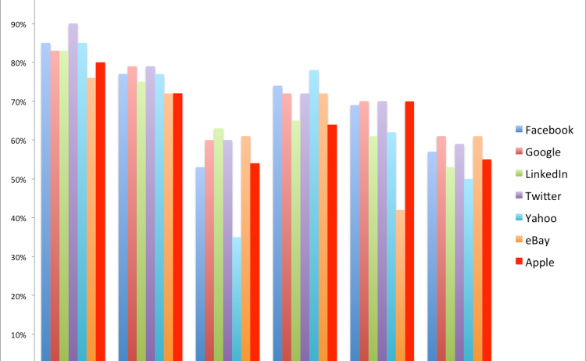
Apple & Google's diversity compared
Both Apple and Google started off as gendered organizations that seemed to emerge as:
  Men being hired more than women.
  Women being hired as support roles and men assuming leadership roles.
  Leadership often rested on a masculine model.
Over many years, both organizations have changed their diversity and began to become more inclusive for women, underrepresented minorities, all races, and LQBTQ+.

Slide 18
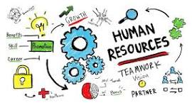
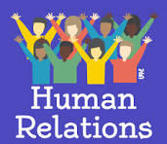
Human relations and human resources
Human relations
Human resources
This approach is about people in a workplace wanting to feel united.
Focuses on the organizations goal while incorporating the important of employee's feelings.
Mary Parker Follett was a social worker who believed that cooperation between people working in groups under leadership would produce excellence in the workplace.
This approach is more concerned with the organization as well as incorporating most assumptions of human relations.
Focusing on the climate as well as how the organization can encourage their employees to participate and dialogue.
Employees are given more freedom to construct organizational reality.

Slide 19
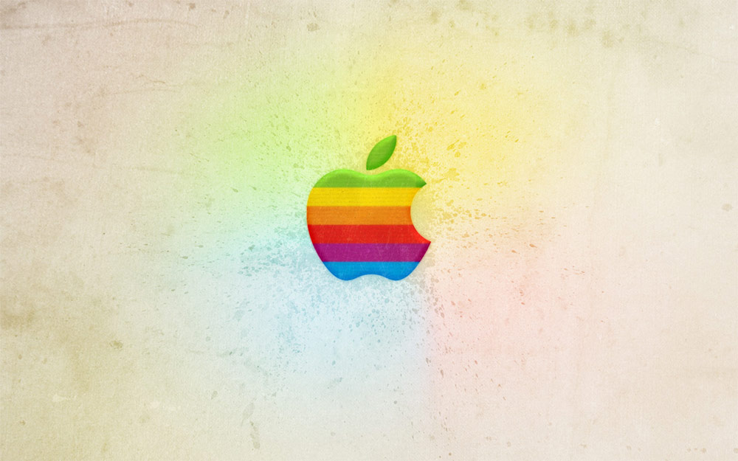
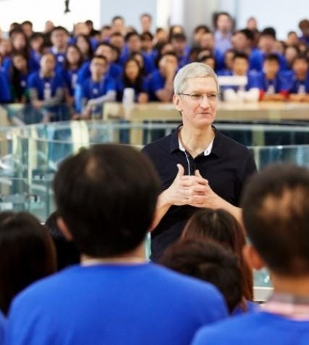
How apple uses the human resources approach
Apple encourages hard work for all employees
They do not provide training or a development program, but instead offers training to their employees on their own time.
  They do not create learning plans for employees.
Apple creates multiple teams of their employees to compete and find new innovative solutions.
New employees know that they should not expect a warm family when working at Apple. They also know that if they can do something great, they will get something incredible in return.
In their HR approach, they do incorporate somethings from human relations.
  If employees can make a major contribution to the company, they will receive an economic reward from Apple.

Slide 20
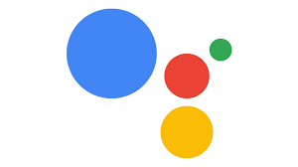
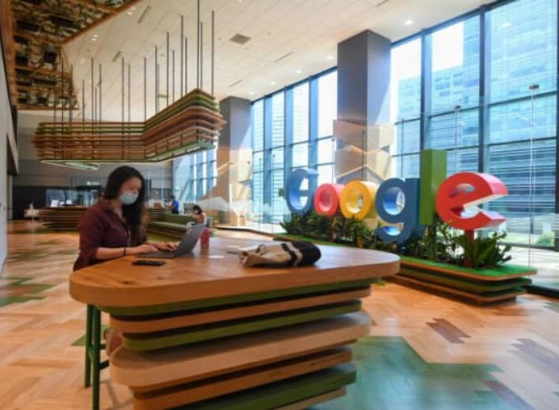
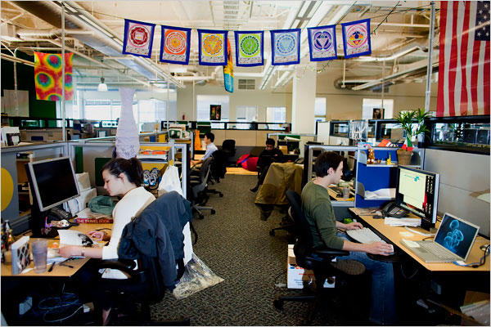
How Google uses the Human relations approach
Google uses the human relation theory by making sure to treat their employees well and treat them like family.
Google provides the best working environment for their employees and has won the Best Working Environment in the U.S. Award.
  The environment makes employees feel relaxed and people oriented.
This company emphasizes the importance of personality and encourages all employees to have individual leisure hobbies.
Google also provides a decoration budget for their employees so they can decorate their own working space to show creativity and comfort.
With this approach, employees at Google can be brought together in diverse groups and address the issue of human differences.

Slide 21
How the companies differ & correlate in Hr
Focuses on employees building their careers and succeeding through their company on their own.
Does not create a layout plan for employees to learn/train.
Provides rewards when employees do something beneficial for the company.
Focuses on their employees feeling welcome and like a family while allowing them to succeed.
Provides criteria for new employees to learn/train.
Always provides free meals, games, and services for their employees to come to work happy.

Slide 22
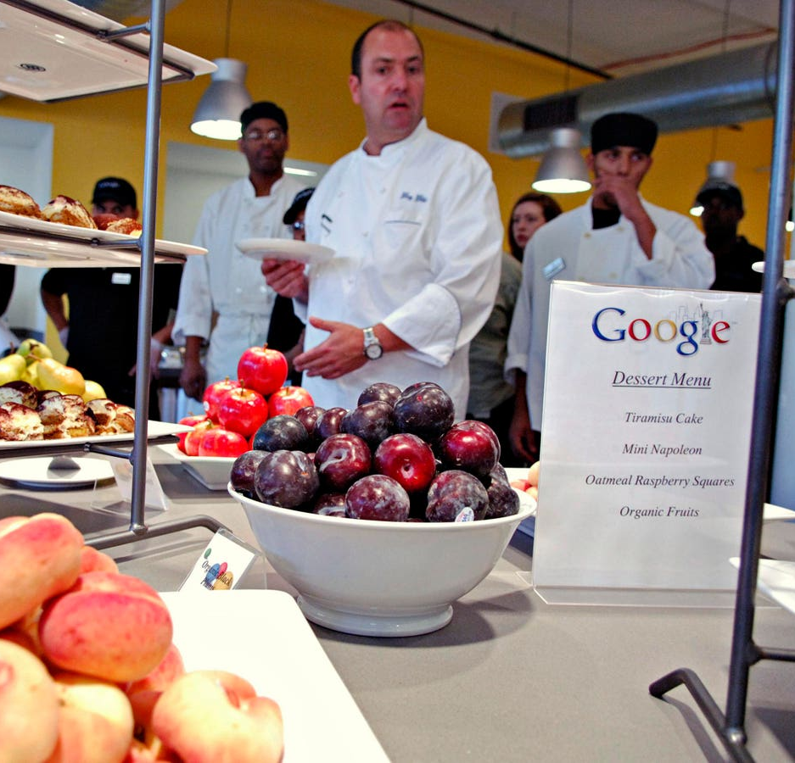
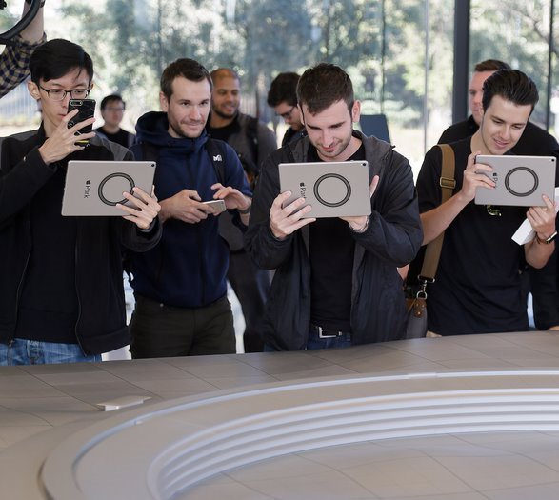
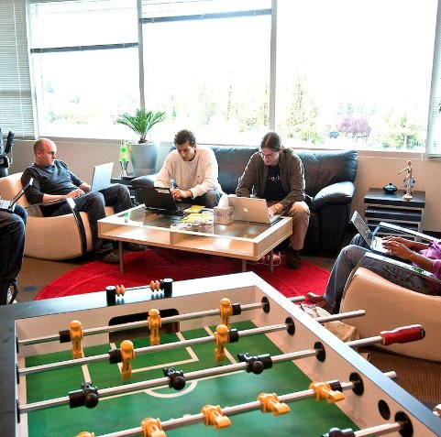
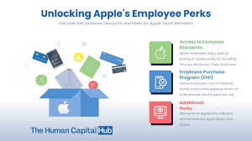
Pictures of Google & Apple's employee perks

Slide 23
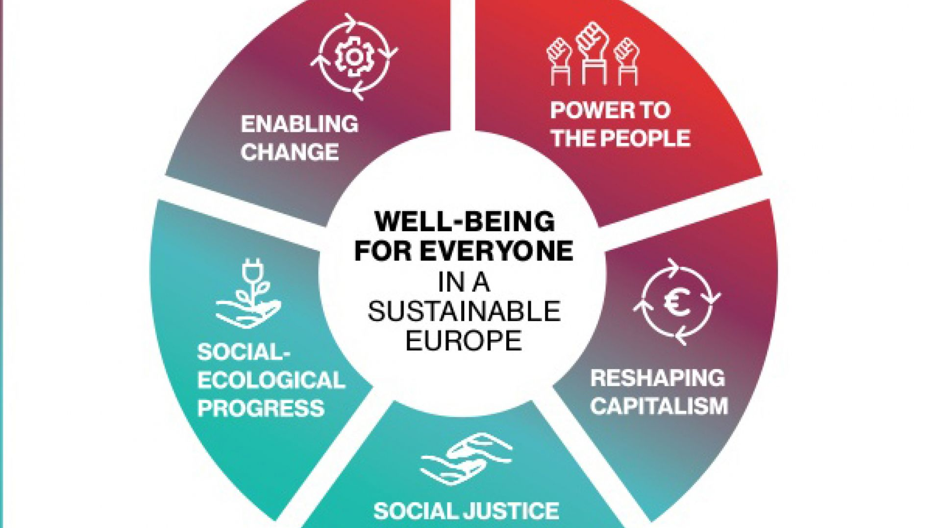
Progressive capitalism
Progressive capitalism was an economic idea that combined principles from capitalism with a focus on social well-being. In the early twentieth century, a connection between employee wages and employee's ability to active consumers was made. In the 1970's corporations and individuals experienced a notable increase in economic well-being.
Overtime, with the globalization of labor, employers would have the option to hire low-wage workers overseas. Despite companies being successful, some were engaging in customs that were like exploitation of workers in the early stages of capitalism.
  Many Americans ignored them because of the distance but recently reports from large, well-known companies surfaced about how they treat their employees.
Since the early 2000s many Americans work one or more low-income jobs and struggle to survive off that. The rich are getting richer, the middle class is shrinking with relatively stagnant wages, and the lower class is becoming poorer.
  With this issues, companies are offered unprecedented opportunities to send more jobs overseas. Outsourcing to poorer nations while increasing reliance on temporary works, companies maximize profits for shareholders but contribute to the widening income gap.
These changes have caused revolutionary impacts and the critical approach to organizational communication pursues to advocate for interests in the working people rather than the interests of corporate leaders and shareholders.

Slide 24
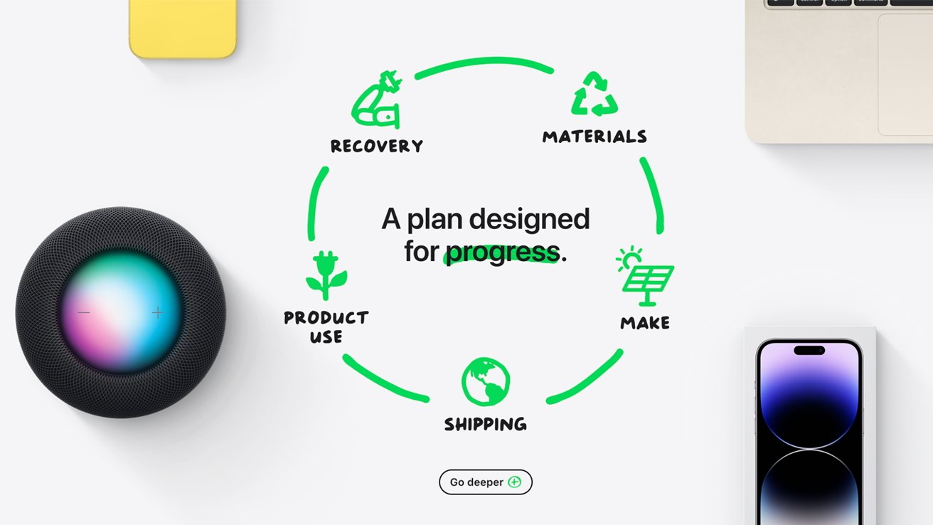
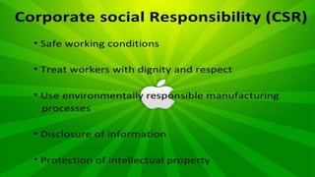
Apple's progressive capitalism initiatives
Apple's organization has taking steps that are like progressive capitalism in areas such as labor practices, social responsibility and environmental sustainability. Apple demonstrates how jobs in the U.S. have been affected by globalization.
Apple has transformed from a company who was based mainly on U.S. made products to mostly all their products being made overseas.
Overtime, Apple has progressed as a company and has taken steps to integrate social and environmental considerations into its business.
Environmentally:
  Apple uses carbon neutral for their corporate operations and hope to achieve making carbon neutral products in years ahead. They have partnered with communities and leaders to ensure their efforts are also for equality and justice.
Socially:
  Apple creates an inclusive and diverse work environment for their employees while respecting the rights of all humans. They empower people by providing accessible technology.
Governmentally:
  Apple has incorporating responsibility and transparency in all levels of their company and continues to have a board that helps to promote informed and effective decision-making.

Slide 25
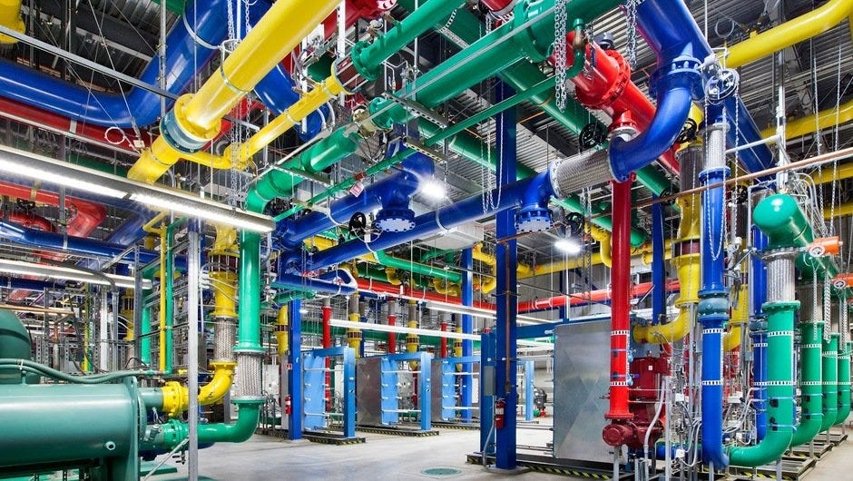
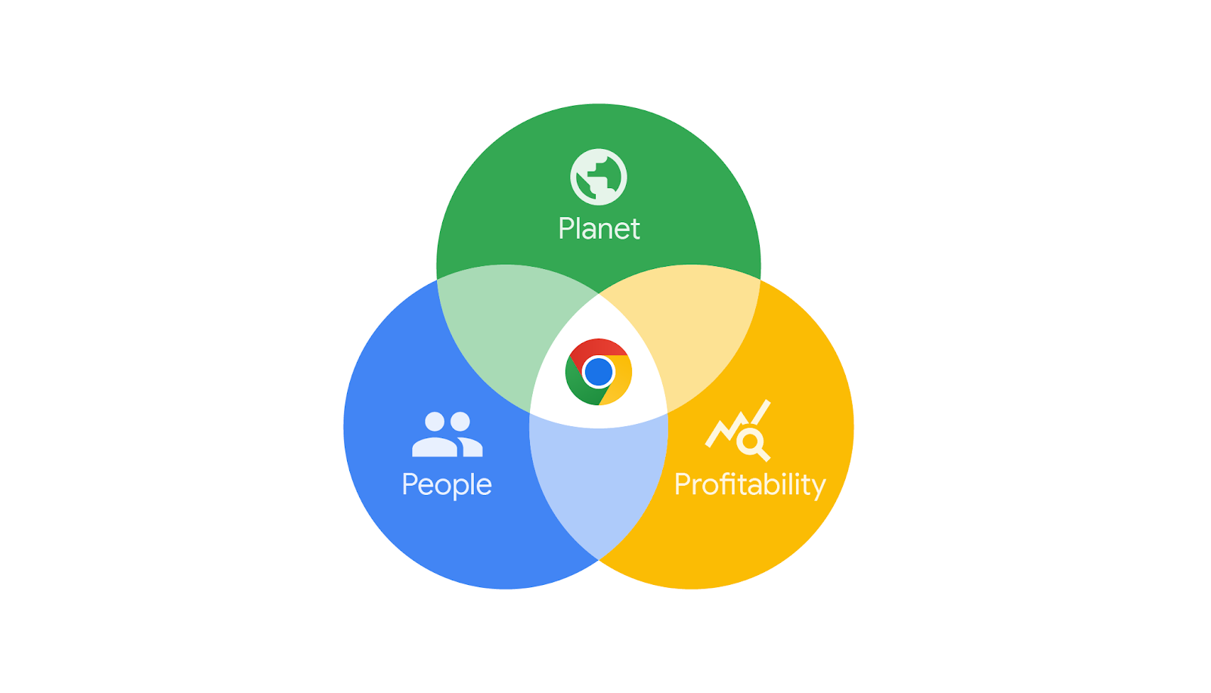
Google's progressive capitalism initiatives
Google uses approaches that align with aspects of progressive capitalism in areas of innovation, diversity, and corporate social responsibility, etc.
Google reached global recognition faster than any other company and have offices in more than 40 countries worldwide. This company has also progressed and has begun to consider environmental, social, and sustainability considerations.
Environmentally:
  Google has started developing technology and products to help ensure individuals have a sustainable life and working to transition to low-carbon systems.
Socially:
  Google is committed to treating all their employees equally and with respect while ensuring safe working conditions.
Sustainability:
  Set forth goals to operate their data centers and offices with clean energy and using solar and wind energy.

Slide 26
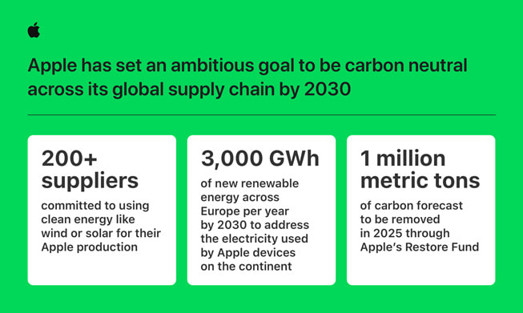
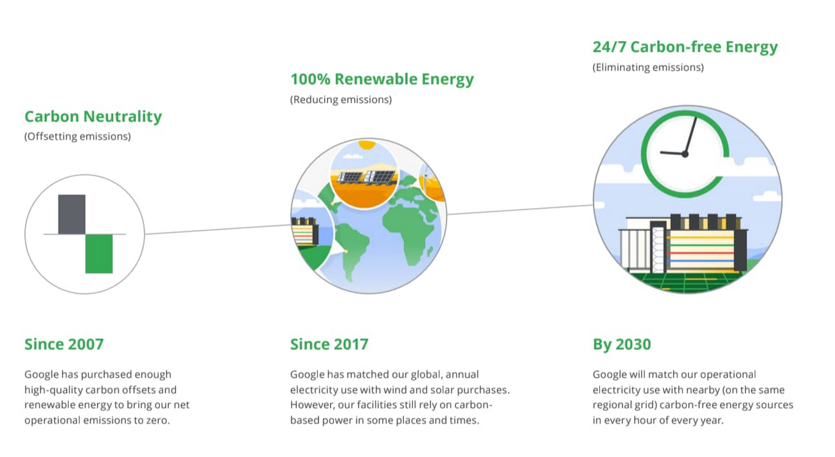
TWO PATHS OF PROGRESSIVE CAPITALISM
Similarities
Apple and Google have both begun incorporating ways to use carbon neutral/low-carbon resources.
Created a diverse and inclusive work environment for employees.
Both have goals to be carbon neutral by 2030.
Differences
Google provides comprehensive benefits and focuses on promoting work-life balance.
Apple focuses more on improving the working conditions.

Slide 27
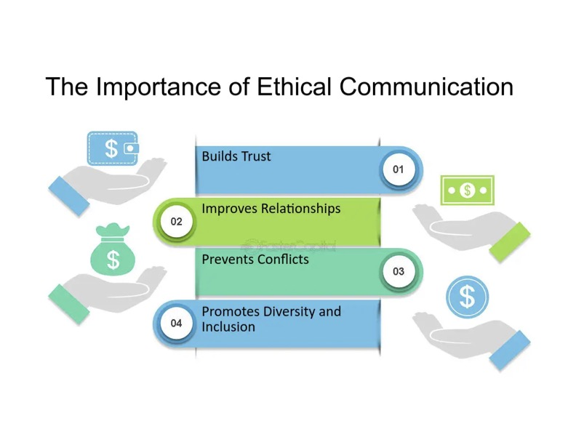
Ethical communication
Ethics are the systems of duties, rules, and morality that are used to guide our behaviors.
In organizational communication, ethics means that both the process and the product need to be considered.
  Process = how we communicate
    Agreements made, decisions, creation of products
  Product = the material and figurative results of communication behaviors.
    Changes in attitudes, relationships, or emotions
Ethical communication is vital for thoughtful decision making and promotes honesty, responsibility, and fairness.
In business cultures, organizational values that are linked with ethical communication suggest that we should:
  Act with integrity
  Tell the truth
  Be open to change
  Keep our word
Rules for ethical communication in business relationships such as the golden rule simply means to follow through with your commitments and make sure others do as well.

Slide 28
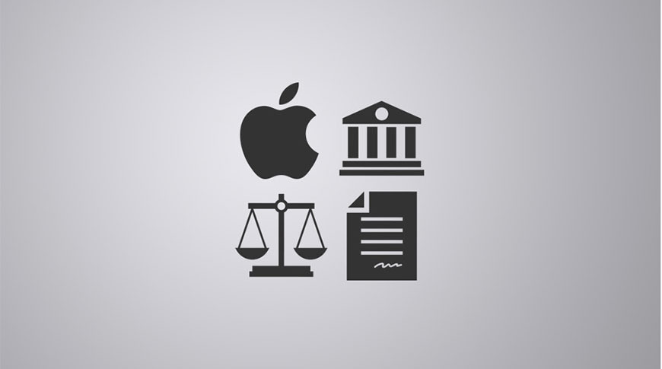
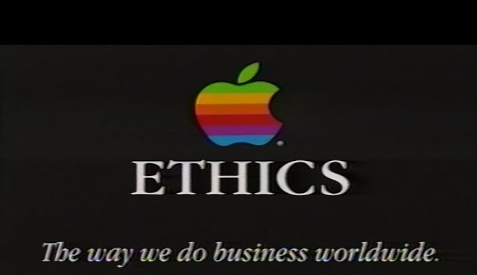
Apple's ethics
Apple's organization manages their business ethically with honesty and compliance with the law.
Every employee must verify that they read and understand the policy when beginning to work at Apple and every year following.
Employees are required to practice honesty, confidentiality, and respect when providing products and services to Apple.
  Treating customers, suppliers, other employees, etc. with courtesy & respect.
Some ethical issues Apple has faced:
  Excessive overtime
  Poor working conditions such as safety risks.
  Crucial communication gaps leading to unsafe working conditions.
  Lacked governance and oversight over human rights risks
  Not clearly stating employee's freedom of expression.

Slide 29
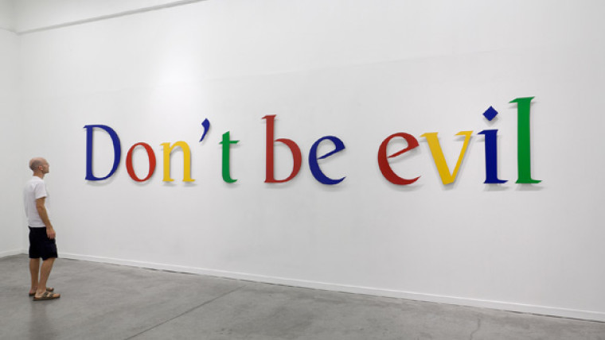
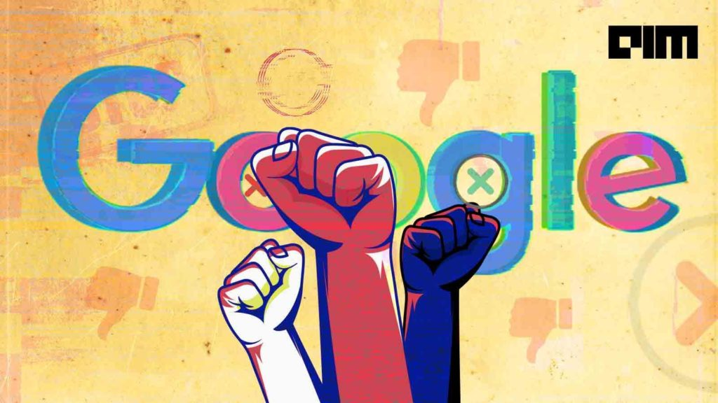
Google's ethics
Google's office policies for the employees:
  Responsibilty. What you say and do matters.
  Be helpful. Employees voices are contributions.
  Be thoughtful.
Google's 3 values to follow when communicating:
  Respect the user, the oppurtunity, and each other.
Employees are required to adhere to the code of conduct guidelines and workplace policies.
In the past years, Google experience some criticism about their ethics including:
  Environmental & financial costs
  Stakeholders rethinking their partnerships with Google because of their heavy investing in AI and machine learning.

Slide 30
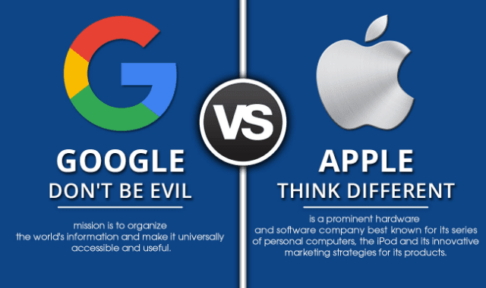
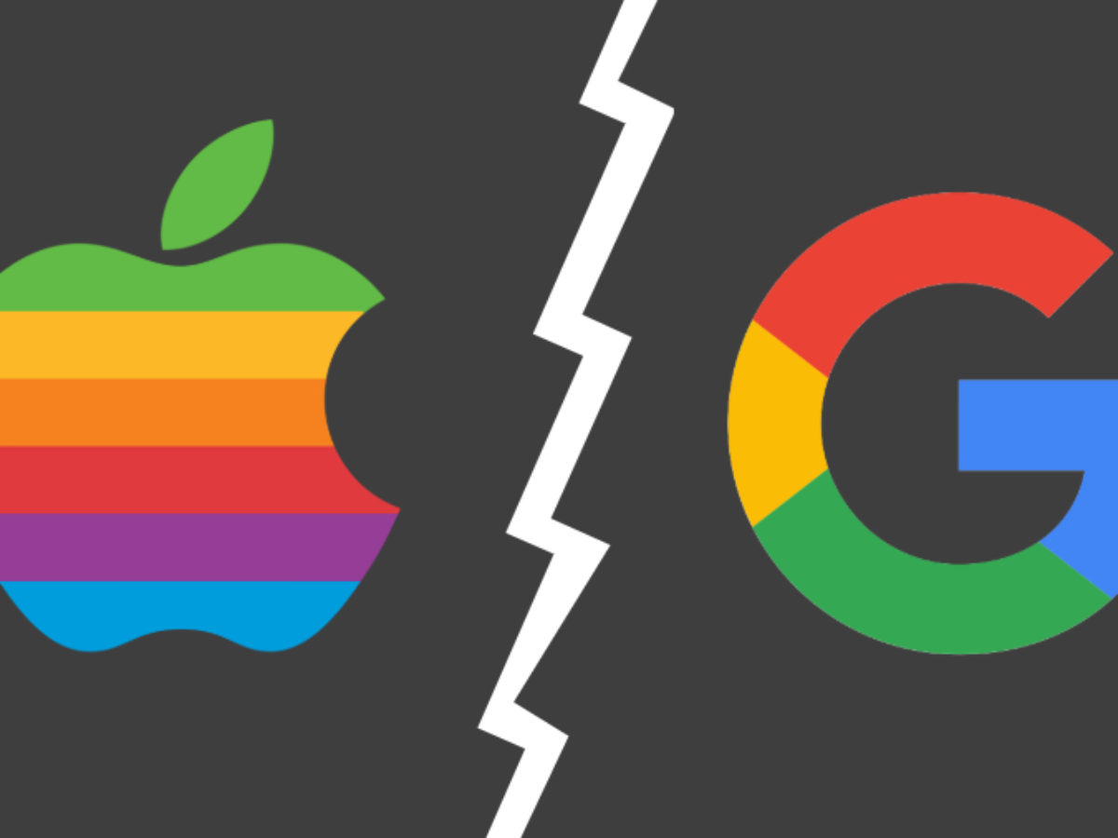
Apple & google's ethics
Apple and Google have similar ethics for their businesses and employees.
Both companies faced some ethical issues in the past, Apple had worse accusations than Google.
All employees must read the ethics guidelines every year and verify that they understand them.
Google lays out more of a list of what their employees should do and Apple just states they must be respectful.

Slide 31


Culture as organizational communication
The culture approach focuses on the formal and informal practices, display of artifacts like interior design and concentrates on human's desire to see organizational life as something meaningful.
Symbols can be seen in office sizes, design, how employees and manager's dress.
The culture of an organization can be studied from the examination of their environment.

Slide 32






Google's office culture
Google's offices embody vibrant colors, design that encourages play, additional seating, and a cafeteria.
  The colors encourage creativity and fun. Play areas allow employees to take breaks and relax. The cafeteria offers free meals that cater to dietary preferences.
Employees dress casually with no strict dress code.

Slide 33


Apples office culture
Apple office buildings have an open-plan office design that hold 80 pods on each floor in their corporate headquarters building. Emerging issues of privacy and noise have been getting solved with products such as:
  Sound-dampening lights
  Numerous dividers
The design of the building hides the roads and parking spaces underground and is powered 100% by renewable energy.
There are glass sliding doors that allow exposure to the outside during nice weather.
Apple employees can meet in their teams at the large story on-site café and are allowed to go outside to work.
Apple also has an on-site gym at their campuses that have medical professionals and physiologists' employees can use.

Slide 34

Apple and Google's different office cultures
Google offers employees more opportunities to express themselves in their private offices.
Google has colors throughout their buildings.
Apple's offices are designed by an open-floor plan and do not allow employees to decorate much.
Apple's décor is simple and does not express color.
Both companies have a non-strict dress code. Casual and business casual is preferred for the different occupations.

Slide 35



